Slide 1

Sagar Institute of Research and Technology, Indore
Recommender System
Team Member :-
Vinay Panwar
Vaishnavi Kaushal
Rupali wanare
Project guide :-
Dr. Sachin Patel

Slide 2
Content :-
Problem Statement
Introduction
Proposed solution
Lacks
conclusion

Slide 3
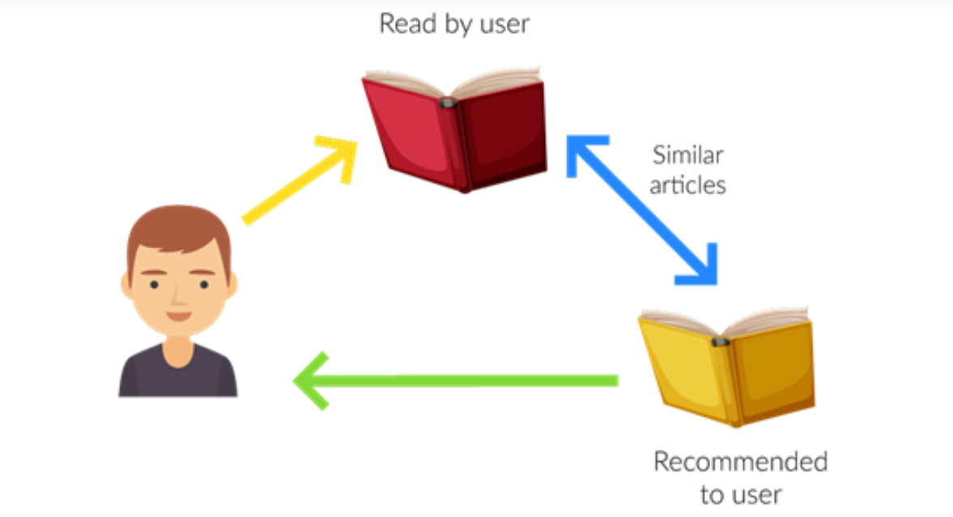
Problem Statement :- Recommender System.
Introduction :- The recommender system can predict whether a particular user would prefer an item or not based on the user’s profile.

Slide 4
Hardware and Software requirement :
Hardware : i3, windows 11, 512 ssd, 8 gb of ram, hard disk 1 TB, high speed internet
Software : visual studio and visual studio code , jupyter notebook, python environment, module like Tkinter for gui, spotipy API, Spotify application, random module, scikit module, matplotlib module, pandas module, numpy module, good working of respective devices, Python admin environment.

Slide 5
Proposed solution :- We are going to create a UI which will take a set of inputs such as user’s searches and some question’s answer, and based on the answer given by user, our system will process that data and recommend one of these (music, book or movie or may be all of these). We are going to use machine learning model and algorithm to process the inputs. There are many machine learning algorithm/model current available that can be used to get our model trained.
Dataset and information are downloaded from Kaggle and other dataset vendors also we’ll preprocess it, so getting misinformation will be far away.
We used spotipy api to get the information of music in industry.

Slide 6
Conclusion :- As per the growing needs of user and lack of time, it requires our more effort to give the optimal solutions for the problems. Our team is going to create an widget board which help user’s to get more insightful brief about their recommendation and customized result. We are working on widget project which help user to get a recommendation for movies, music ,and books.
Currently we are working only for music recommendation.

Slide 7
Thank You

